Slide 1
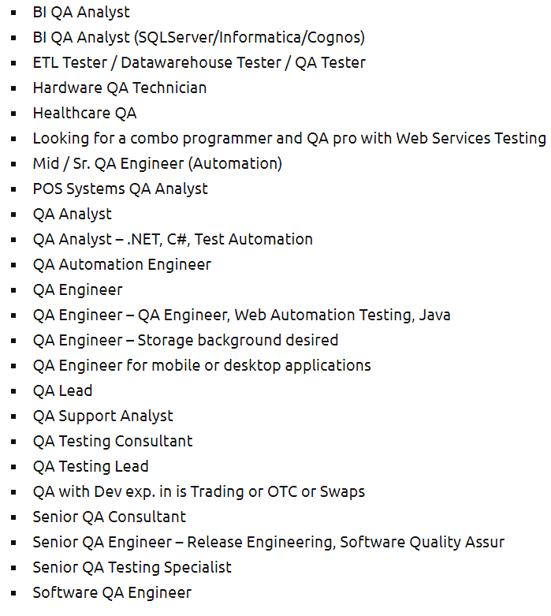
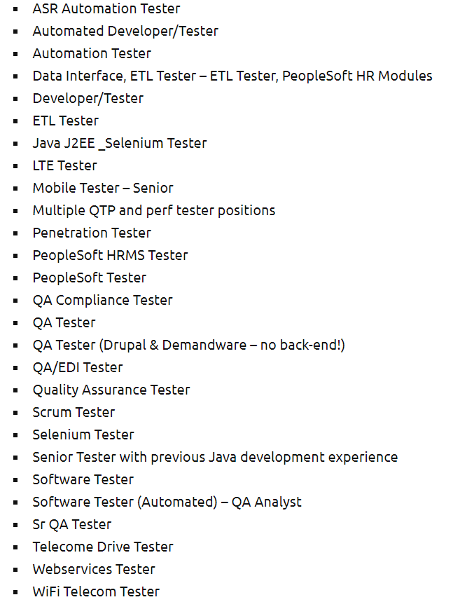
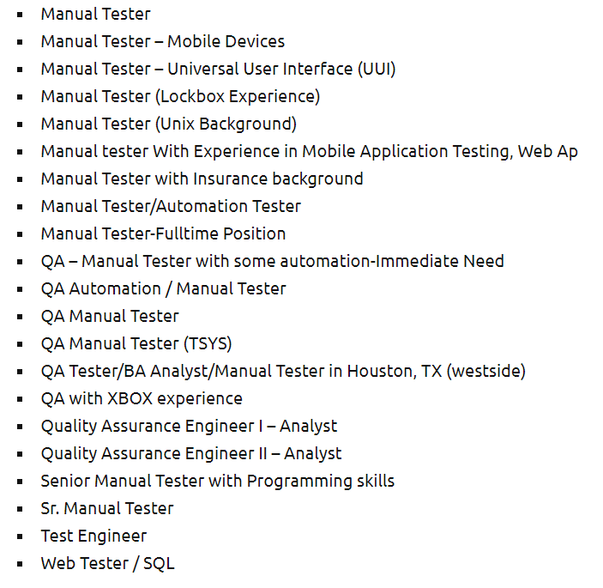
Before start

Slide 2

Myth or True? Menti.com Code:

Slide 3
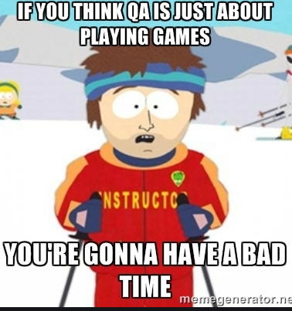
Stereotypes
Video

Slide 4
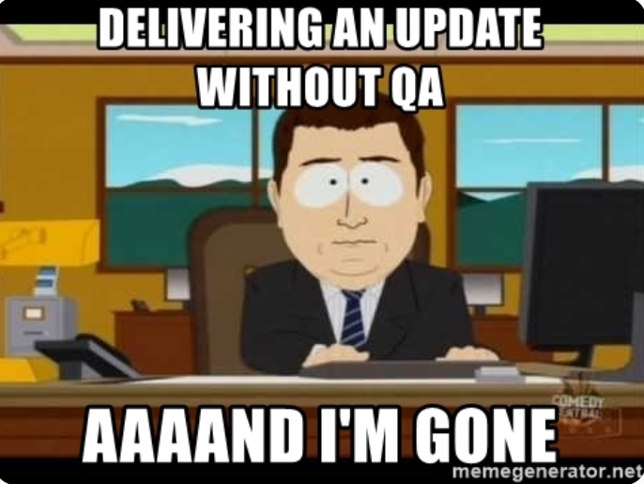
Google it!
Is QA a bad job?<..> But if you think about it, jobs related to QA are actually not bad after all.<..>
Is QA really necessary? QA-based testing is important, whether implemented as a support role for development teams <..>
Is QA testing dying? At a high level, software QA as a guiding process is dying, though testing will always be needed
Is quality assurance boring? Many testers get bored due to their monotonous job <…>
How do you deal with QA? Respect for QA . “Don't take it personally” is advice that's easier said than done.

Slide 5

Facts!
Myth - Testing is too expensive
Fact! What costs more money - paying for proper testing or the lost opportunities and market share created by a buggy software release?
Myth - Testing is easy, no formal training is needed:
Fact! In reality, quality and thorough software testing is very challenging

Slide 6
Facts!
Myth - A software tester’s only task is to find bugs... Period <..>
Fact! Testers do not only test, they understand the development process and business goals of your software.
Myth - Automation eliminates the need for manual testing
Fact! Automation testing is no substitute for manual testing.
Myth - Testing means bug-free code.
Fact! Testing merely helps identify the bugs in software

Slide 7
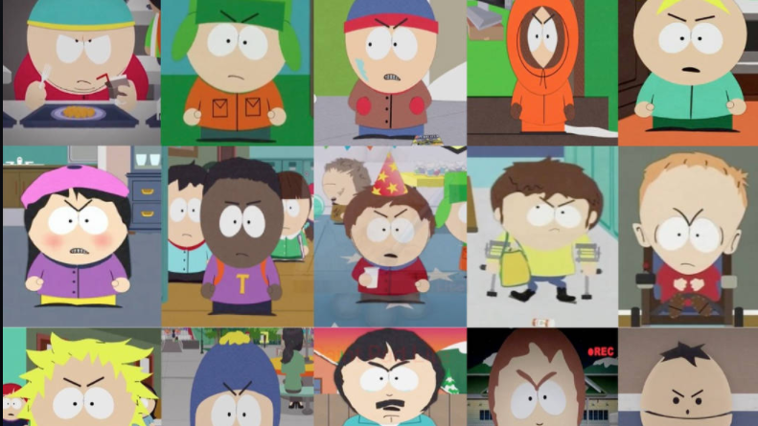
Types of testers

Slide 8
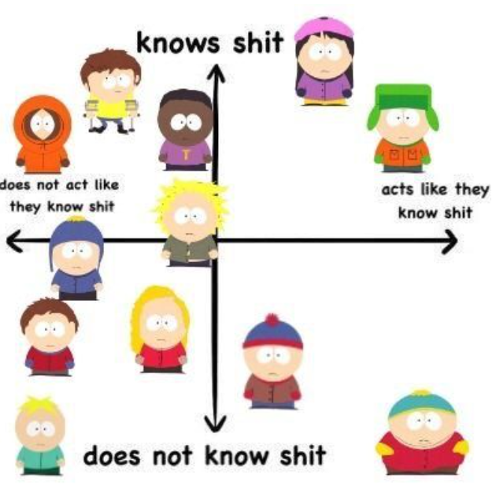
Types of testers
The curious tester - often think outside the box.
Tester to the letter - makes extra effort
The stubborn tester - will not give up
The thorough tester - clear and structured
Diplomatic tester - gives constructive criticism
Life-long learner tester - focus on keeping up to date
The enthusiastic tester - the one who is eager to work
The eager tester - perfectionist, likes to hack the system
https://reqtest.com/testing-blog/what-makes-a-great-tester-infographic/

Slide 9
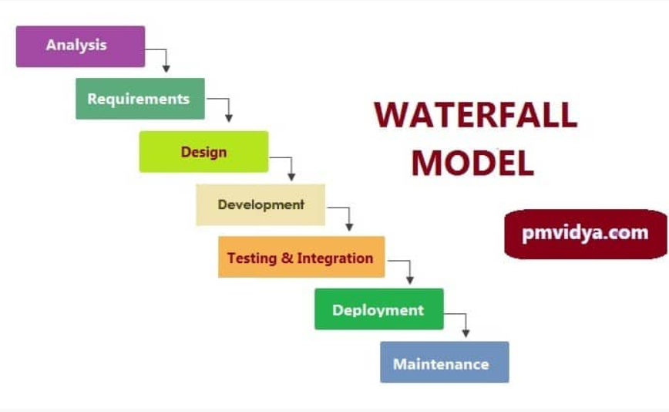
Testing in Waterfall model
Waterfall Testing: Waterfall Testing is a type of software testing in which testing is a different phase and there are steps anf steps classified and testing is performed only in that order.
Notes:
https://www.geeksforgeeks.org/difference-between-agile-testing-and-waterfall-testing/

Slide 10
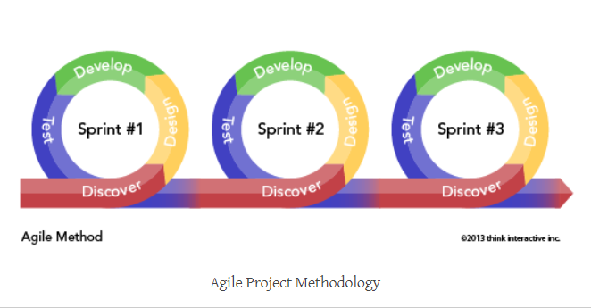
Testing in Agile
Agile Testing: Agile Testing is a type of software testing that involves all members of the project team, special experts and testers

Slide 11
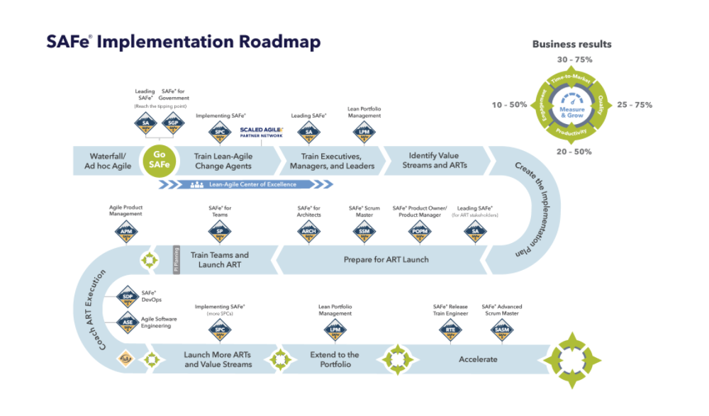
Testing in safe

Slide 12
Difference between Agile Testing and Waterfall Testing
Agile testing | Waterfall testing
In agile testing, testing is not a separate phase. | In waterfall testing, testing is a separate phase
In agile testing, testing is performed alongside the development. | In waterfall testing, testing is carried out only after the completion of development.
In agile testing, development team and testing team work together. | In waterfall testing, development team and testing team work separately
In agile testing, testers are involved in the requirements. | In waterfall testing, testers may or may not be involve in the requirements.
In agile testing, acceptance testing is carried out after every iteration. | In waterfall testing, acceptance testing is carried out only in the end.
In agile testing, regression testing is carried out after every iteration. | In waterfall testing, regression testing is carried out only in the end.
In agile testing, different testing levels overlap. | In waterfall testing, testing levels can’t overlap.
https://www.geeksforgeeks.org/difference-between-agile-testing-and-waterfall-testing/

Slide 13
Break

Slide 14
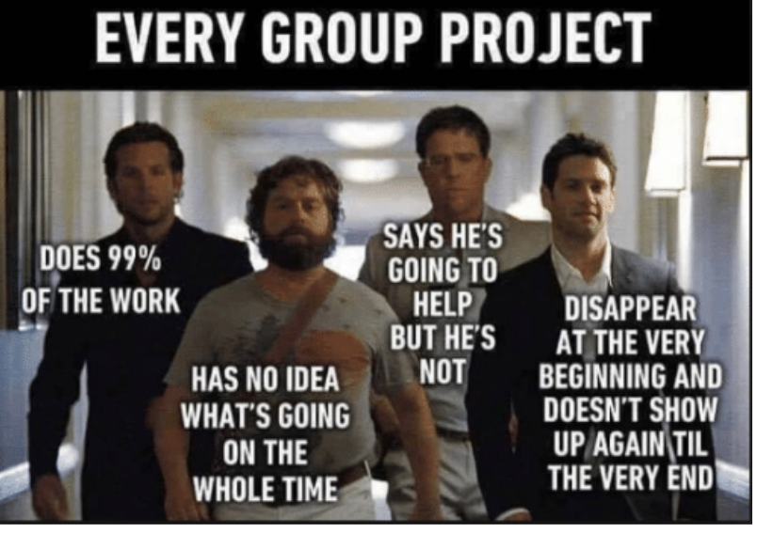
Tester vs other roles in Agile team

Slide 15
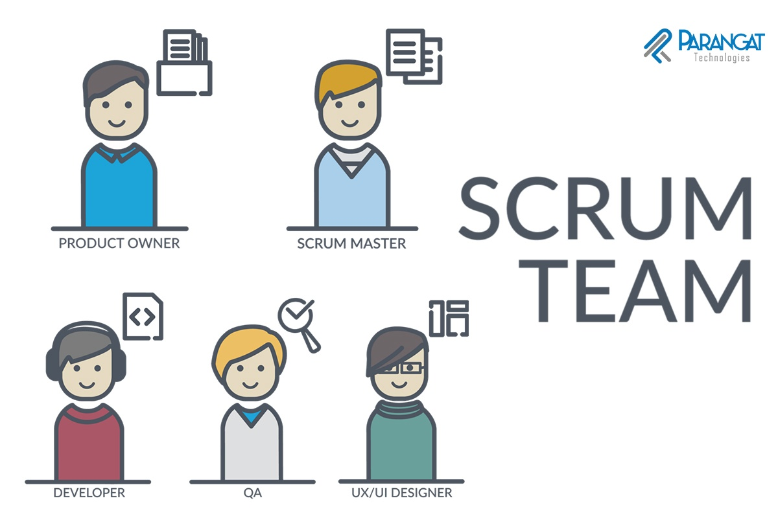
Scrum team

Slide 16
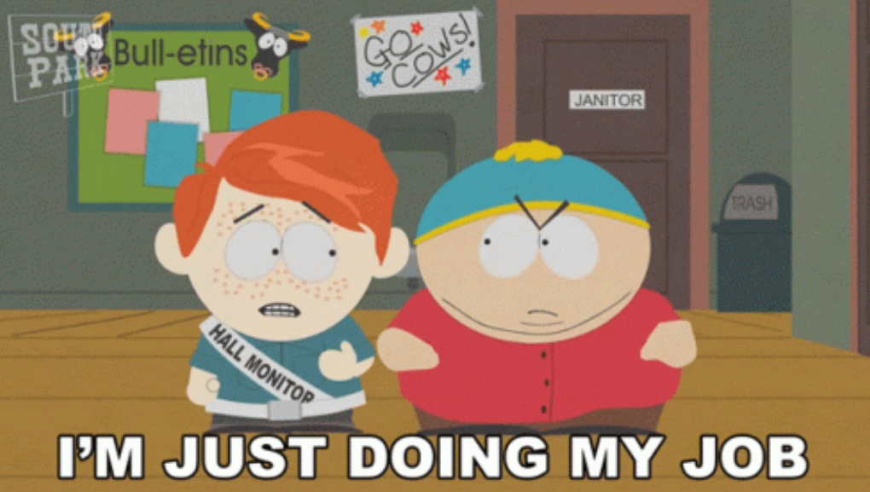
Tester vs other roles in Agile team
Resposnabilities:
Analyzing user stories and/use cases/requirements for validity and feasibility
collaborate closely with other team members and departments
execute all levels of testing (System, Integration, and Regression)
Design and develop automation scripts when needed
Detect and track software defects and inconsistencies
Provide support and documentation

Slide 17
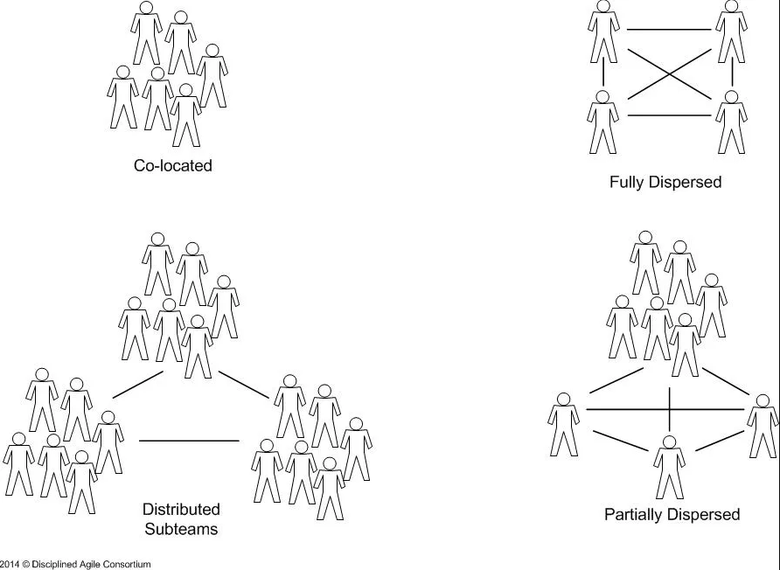
Teamwork in distributed team
Risks:
Communication challenges
Temporal challenges
Cultural challenges
How to overcome risks?
Team members
Shared purpose
Technology and tools

Slide 18

Be productive
Organize your daily tasks
You do not manage time; you manage tasks and priorities
Don't let tasks pile up; that will only cause you more stress
Zero distractions
„Eat the frog“ – Mark Twai

Slide 19
Soft skills: The most essential skills for a QA‘s
Attention to detail.
Time management.
Problem-solving.
Multitasking.
Written and verbal communication.
Ability to work as part of a team.
Knowledge of quality standards.

Slide 20
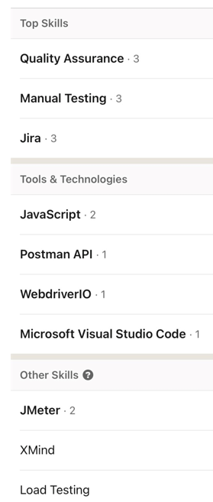
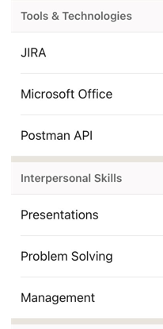
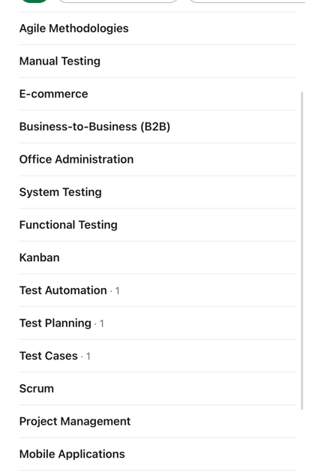
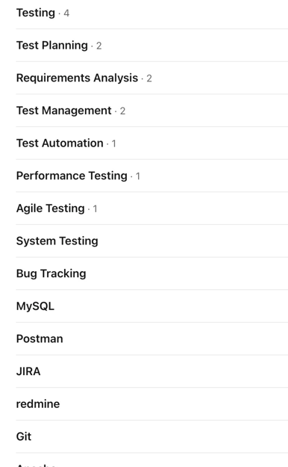
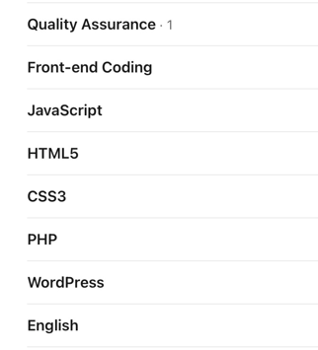
Skills from Linkedin world:

Slide 21
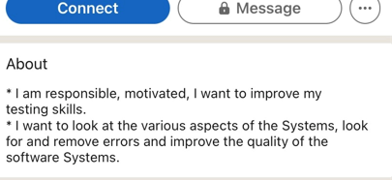
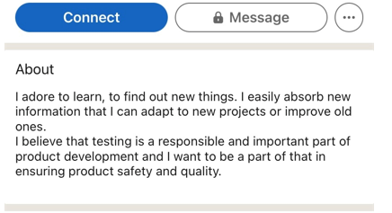
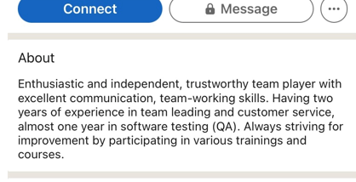
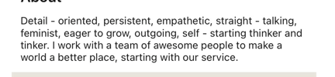
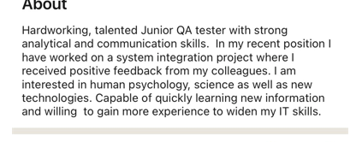
QA‘s: what are we talking about ourselves?

Slide 22
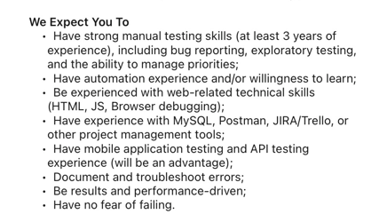
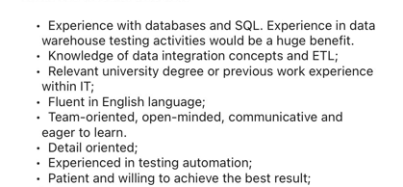
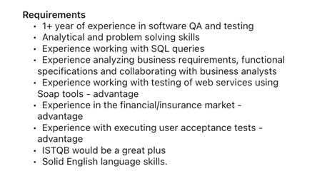
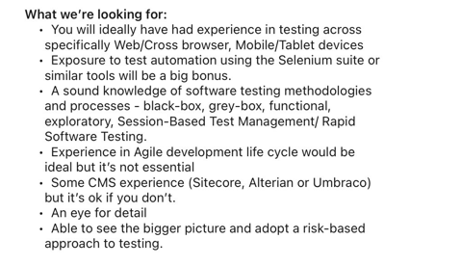
Employers: what are they looking for?

Slide 23
Exam!
Kahoot!
Join at www.kahoot.it
or with the Kahoot! app

